Slide 1
Bibit.id Problem Solving Test
By - Lauw Dastin Falentino Laurianto

Slide 2
Topic
01.
02.
User Behavior
User Retantion & AUM
How user behave while using bibit in 2021?
How to enchane User Retention and increase AUM for 2022?

Slide 3
User Behavior

Slide 4
Investment Product Preference
62%
16%
21%
2%
Pasar Uang Only
Pendapatan Tetap Only
Saham Only
Campuran Only
39% of User is only buying one investment product
AVG Buying Freq : 1.34
AVG Selling Freq : 0.42
AVG Buying Freq : 1.31
AVG Selling Freq : 0.45
AVG Buying Freq : 1.33
AVG Selling Freq : 0.38
AVG Buying Freq : 1.21
AVG Selling Freq : 0.50

Slide 5
Investment Product Preference
85%
Two Products
61% of User is buying more than one investment product
Four Products
2%
13%
35% Pasar Uang & Saham
34% Pasar Uang & Pendapatan Tetap
27% Pendapatan Tetap & Saham
5% Of other combination with Campuran
Three Products
Other Combination with
Campuran inside it only
contribute 0.4%

Slide 6
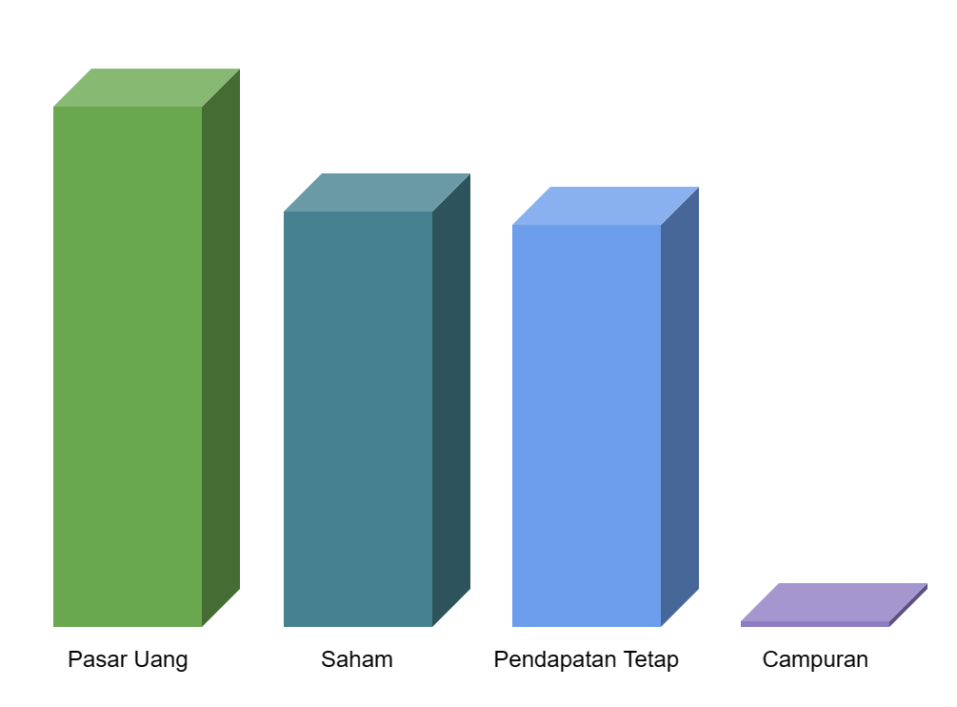
What can we notes?
Most user prefer Pasar Uang as one of their investment product since it have the lowest risk.
Saham becomes the second most preferred investment product where it gives a higher return then Pasar Uang but comes with higher risk as well.
Pendapatan Tetap trails right behind Saham popularity while only a few user willing to buy Campuran as one of their investment product.
A more deep dive into user behavior can be done by analyzing data such as payment method that they choose when doing transaction inside Bibit.id.
By doing this, company can plan accordingly to encourage user to do more transaction by giving promo or benefit for one or more specific payment method.

Slide 7
User Retention & AUM

Slide 8
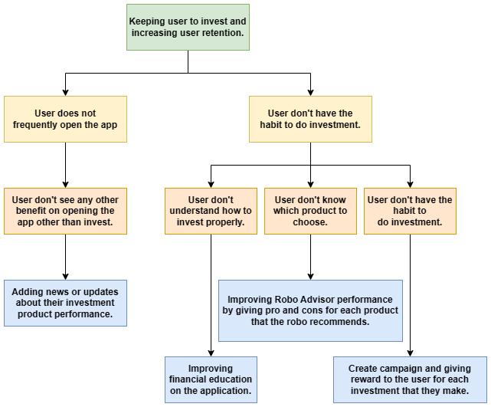
How to Enchance User Retention in 2022?
Analysis on user frequency to open the app is needed to be done. From this, company can gain insight on user behavior as well.
With understanding the user behavior, company can develop strategies to enhance user retention. One which is improving the article section to give insight about certain investment product performance to the user.
By doing so, user will be noticed and can develop a habit to open the app frequently to get information. With that, user might also begin to invest more which will also help increase AUM.

Slide 9
38.5 Bio
The Total AUM for Year 2021

Slide 10
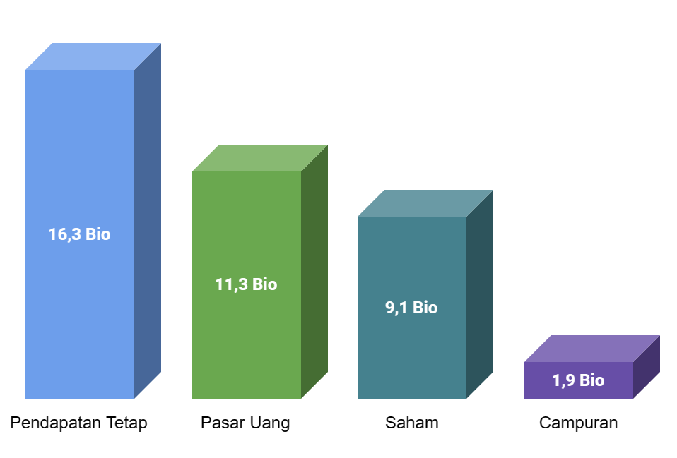
How to Increase AUM in 2022?
Reviewing the affects of Robo Advisor in encouraging new investor to start investing in Bibit.id.
Adding more feature and metrics into Robo Advisor so that it be more useful for more experienced investor.
Reviewing the performance of financial education that have been provided to user through the application.
Maximizing the potential of investment product that already have high AUM such as Pendapatan Tetap by highlight it to investor and maintaining it’s performance.
AUM Breakdown in 2021

Slide 11
Thank You

